Slide 1

Université de Mostaganem — Dr. Madani BELACEL
TIC COURSE 05
Spreadsheet: Microsoft Excel
Dr. BELACEL Madani
Année universitaire 2026-2027 / Academic Year 2026-2027
Université de Mostaganem - Département Mathématiques et Informatique

Slide 2
Université de Mostaganem — Dr. Madani BELACEL
Course Outline
▪ 1. What Is a Spreadsheet?
▪ 2. Workbook, Sheets and Cells
▪ 3. Formulas and Functions
▪ 4. Formatting and Tables
▪ 5. Charts
▪ 6. Data Analysis
▪ 7. Printing and Best Practices

Slide 3
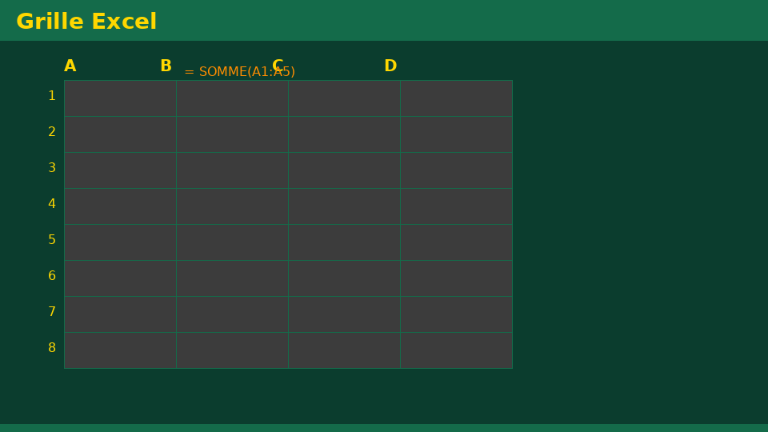
Université de Mostaganem — Dr. Madani BELACEL
Section 1
What Is a Spreadsheet?

Slide 4
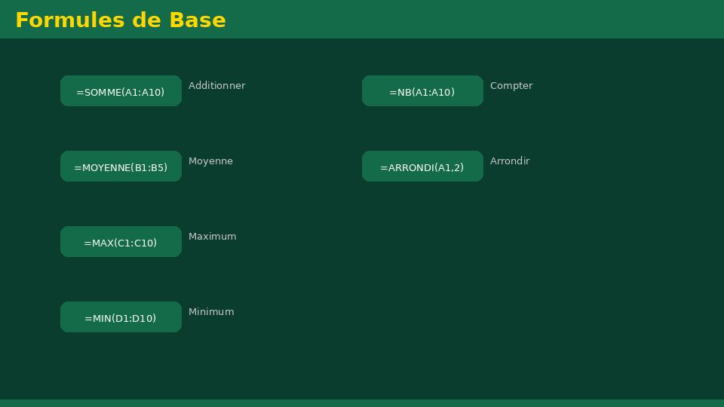
Université de Mostaganem — Dr. Madani BELACEL
1 - What Is a Spreadsheet?
▪ Software for automatic calculation on worksheets.
▪ Grid of cells organized in rows and columns.
▪ Automatic recalculation when data changes.
▪ Uses: budgets, grades, statistics, invoices.

Slide 5
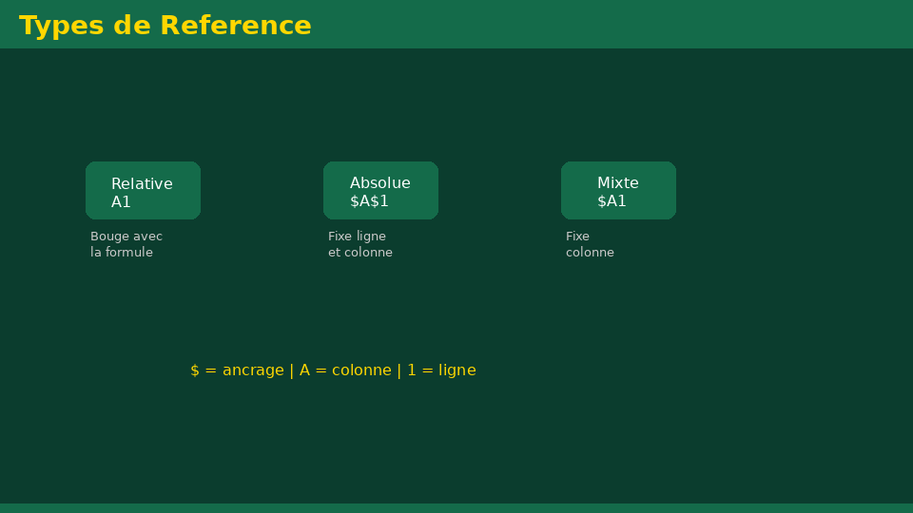
Université de Mostaganem — Dr. Madani BELACEL
Section 2
Workbook, Sheets and Cells

Slide 6
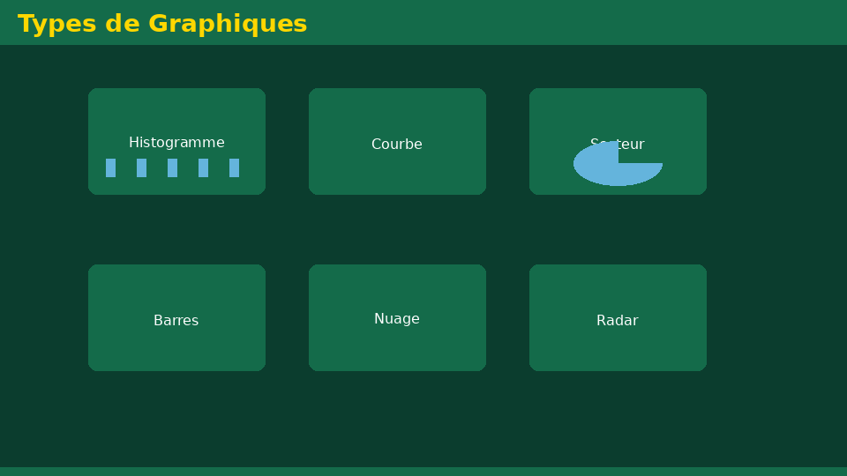
Université de Mostaganem — Dr. Madani BELACEL
2 - Workbook, Sheets and Cells
▪ Workbook = an Excel file containing several sheets.
▪ Cell: row/column intersection (e.g., B4).
▪ Range: continuous set of cells (e.g., A1:C10).
▪ Content types: numbers, text, dates, formulas.
▪ Relative (A1) and absolute ($A$1) references.

Slide 7
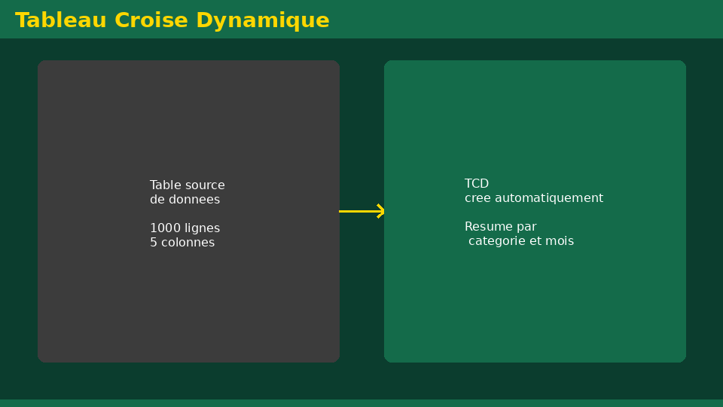
Université de Mostaganem — Dr. Madani BELACEL
Section 3
Formulas and Functions

Slide 8
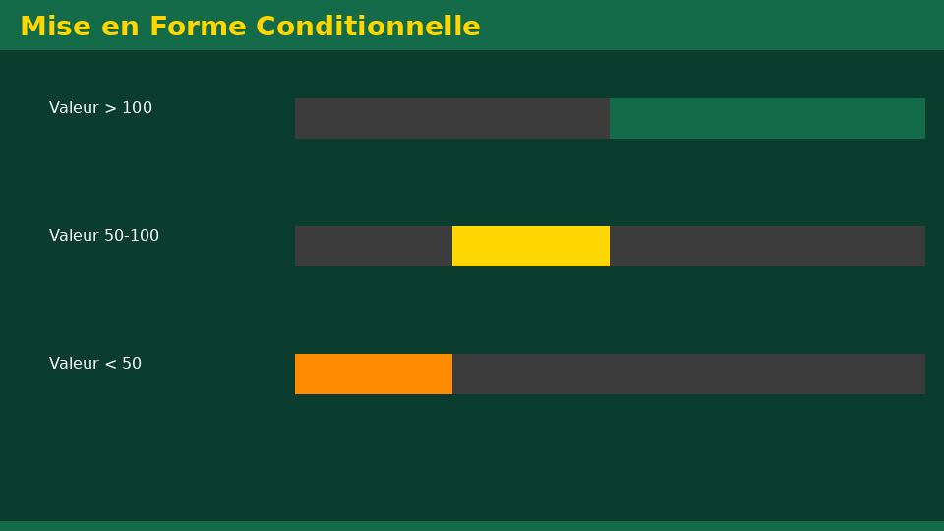
Université de Mostaganem — Dr. Madani BELACEL
3 - Formulas and Functions
▪ Every formula starts with =.
▪ Operators: + - * / % ^ ; calculation precedence.
▪ Common functions: SUM, AVERAGE, MAX, MIN, COUNT.
▪ Conditional functions: IF, COUNTIF, SUMIF.
▪ Function wizard fx: finding functions.

Slide 9
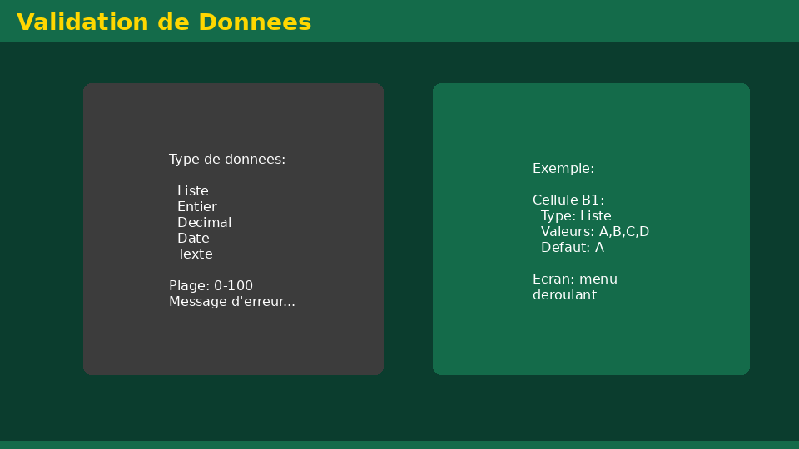
Université de Mostaganem — Dr. Madani BELACEL
Section 4
Formatting and Tables

Slide 10
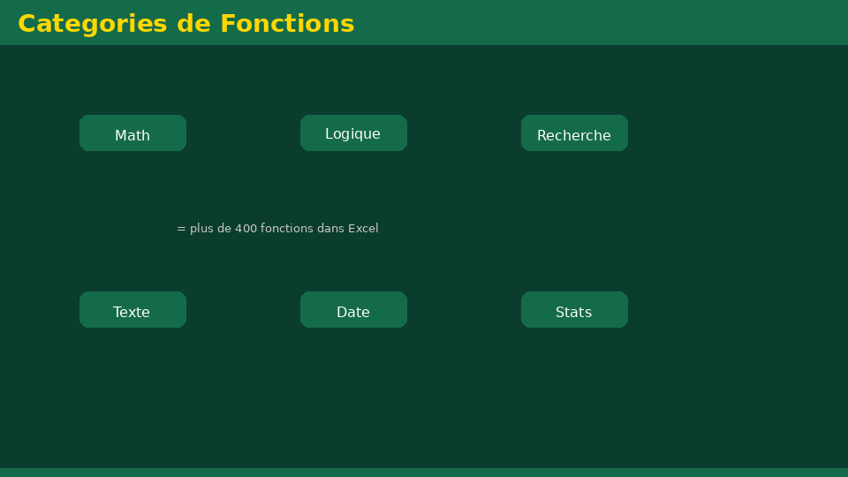
Université de Mostaganem — Dr. Madani BELACEL
4 - Formatting and Tables
▪ Number formats: currency, percentage, decimals.
▪ Colors, borders, cell merging.
▪ Conditional formatting: colored thresholds.
▪ Structured tables and data sort/filter.

Slide 11
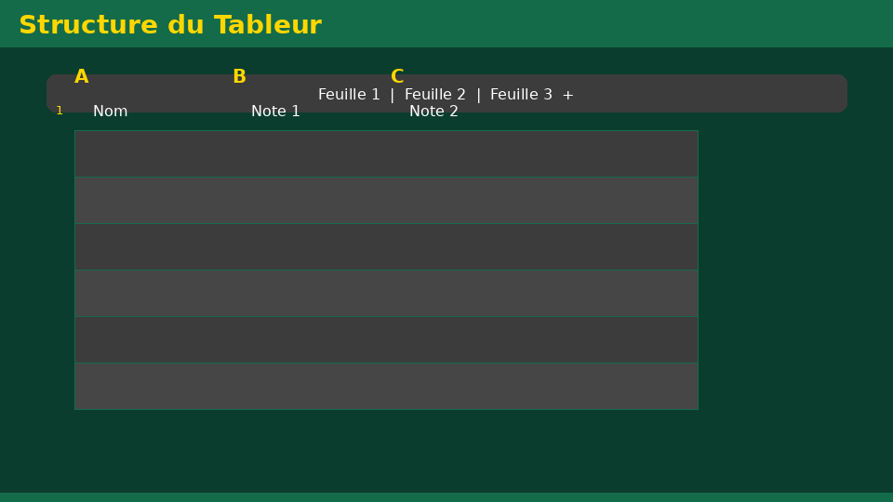
Université de Mostaganem — Dr. Madani BELACEL
Section 5
Charts

Slide 12
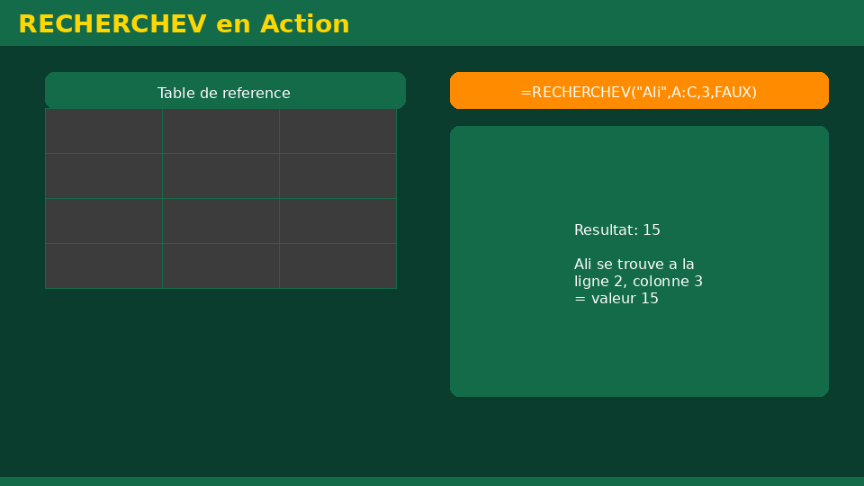
Université de Mostaganem — Dr. Madani BELACEL
5 - Charts
▪ Visualize data: column charts, line charts, pie charts.
▪ Creation: select data > Insert > Chart.
▪ Elements: title, axes, legend, labels.
▪ Change chart type, colors and data source.

Slide 13
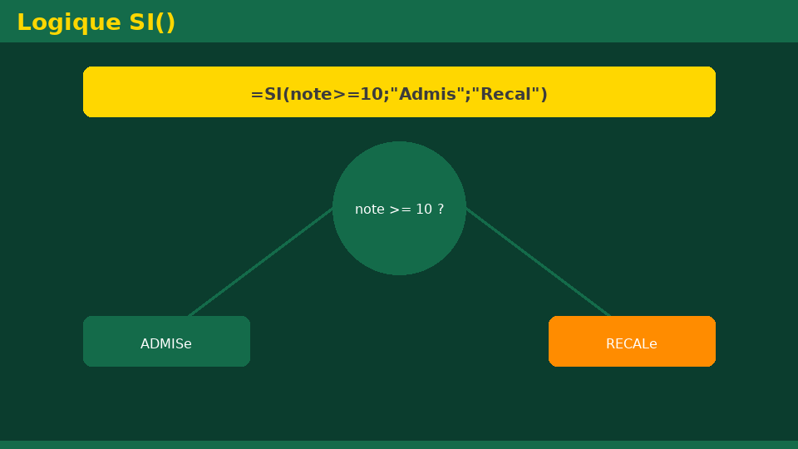
Université de Mostaganem — Dr. Madani BELACEL
Section 6
Data Analysis

Slide 14
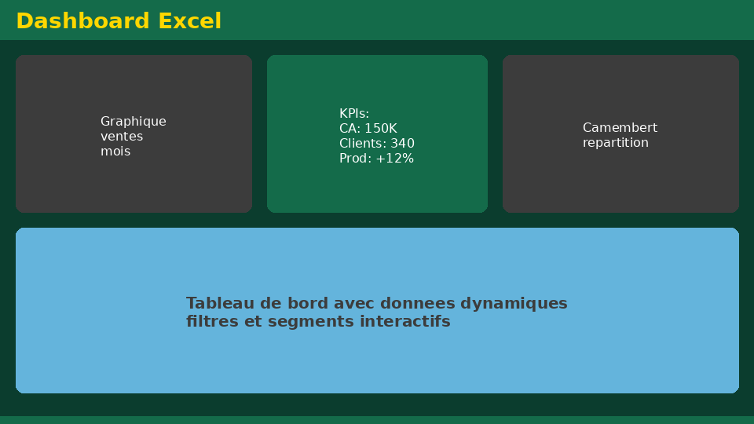
Université de Mostaganem — Dr. Madani BELACEL
6 - Data Analysis
▪ Ascending/descending sort by one or more columns.
▪ Auto-filters to extract subsets.
▪ Pivot tables: quick summaries.
▪ Goal Seek and what-if tables.
▪ Data validation: drop-down lists, constraints.

Slide 15
Université de Mostaganem — Dr. Madani BELACEL
Section 7
Printing and Best Practices

Slide 16
Université de Mostaganem — Dr. Madani BELACEL
7 - Printing and Best Practices
▪ Print area, page setup, fit to one page.
▪ Freeze panes and hide unnecessary rows/columns.
▪ Name sheets and add comments.
▪ Protect cells with a password.

Slide 17
Université de Mostaganem — Dr. Madani BELACEL
Practical Interest
▪ Automatically compute student averages and rankings.
▪ Manage a budget or inventory without manual errors.
▪ Produce charts to present results.
▪ Analyze large datasets with pivot tables and filters.

Slide 18
Université de Mostaganem — Dr. Madani BELACEL
Self-Assessment (MCQ)
1. A formula always starts with:
a) The = sign
b) The + sign
c) The letter F
2. AVERAGE(A1:A10) computes:
a) The sum
b) The average of cells A1 to A10
c) The maximum
3. $A$1 is a(n) reference:
a) Relative
b) Absolute
c) Mixed

Slide 19
Université de Mostaganem — Dr. Madani BELACEL
Conclusion
▪ Excel automates calculations and data visualization.
▪ Formulas, functions and charts are the key tools.
▪ Pivot tables enable professional analysis.
▪ Next course: PowerPoint presentations.

Slide 20
Université de Mostaganem — Dr. Madani BELACEL
References
- Microsoft Support - Excel Guide.
- J. Walkenbach, "Excel 2019 Bible", Wiley.
- ICT Course materials, University of Mostaganem.
- excel-easy.com

Slide 21
Université de Mostaganem — Dr. Madani BELACEL
Thank you for your attention!
Questions?
Dr. BELACEL Madani

